Slide 1
ALBANIA Political Engagement 2020
IDM - Institute for Democracy and Mediation
and
NDI – National Democratic Institute in Albania
Notes:
Add NED=s logo in btw the two logos

Slide 2
Objective
The National Democratic Institute (NDI) commissioned the Institute for Democracy and Mediation (IDM) to conduct the second survey of Political Engagement in Albania. The first survey was conducted in 2016.
The survey assessed the level of citizen engagement in democratic processes – from voting to civic campaigns--and measured changes in the degree of participation since 2016.
The survey is modelled on the Audit of Political Engagement designed by the United Kingdom´s Hansard Society to measure level of political engagement.
The survey is funded by the National Endowment for Democracy (NED). The views expressed in the survey do not necessarily reflect those of NDI or NED.

Slide 3
Core indicators of engagement
Knowledge and interest – How much citizens feel they know about politics and political institutions, and how much they are interested in the issues/institutions.
Engagement and participation – The extent to which citizens are participating in a broad range of political and civic activities/initiatives.
Efficacy and satisfaction – The extent to which citizens believe that politically engagement can bring change, and their level of satisfaction with political institutions.
Perceptions of parliament, political parties and political processes–Citizen attitudes toward parliament performance, MP accountability, political party funding, and voter participation.

Slide 4
Methodology
DATA COLLECTION
June 14 – July 15
METHOD
Face to face interview and focus groups (4)
POPULATION
Albanian population aged 18+
SAMPLE FRAME
Most recent population data from INSTAT (January 2020)
SAMPLE SIZE
N= 1,536 distributed in 12 regions, based on the ‘Proportional to Size’-method
SAMPLING ERROR
±2.5% confidence interval in a 95% confidence level
SAMPLE TYPE
National representative survey with a stratified sample
STRATIFICATION
Within each entity the sample was stratified by region and administrative unit

Slide 5
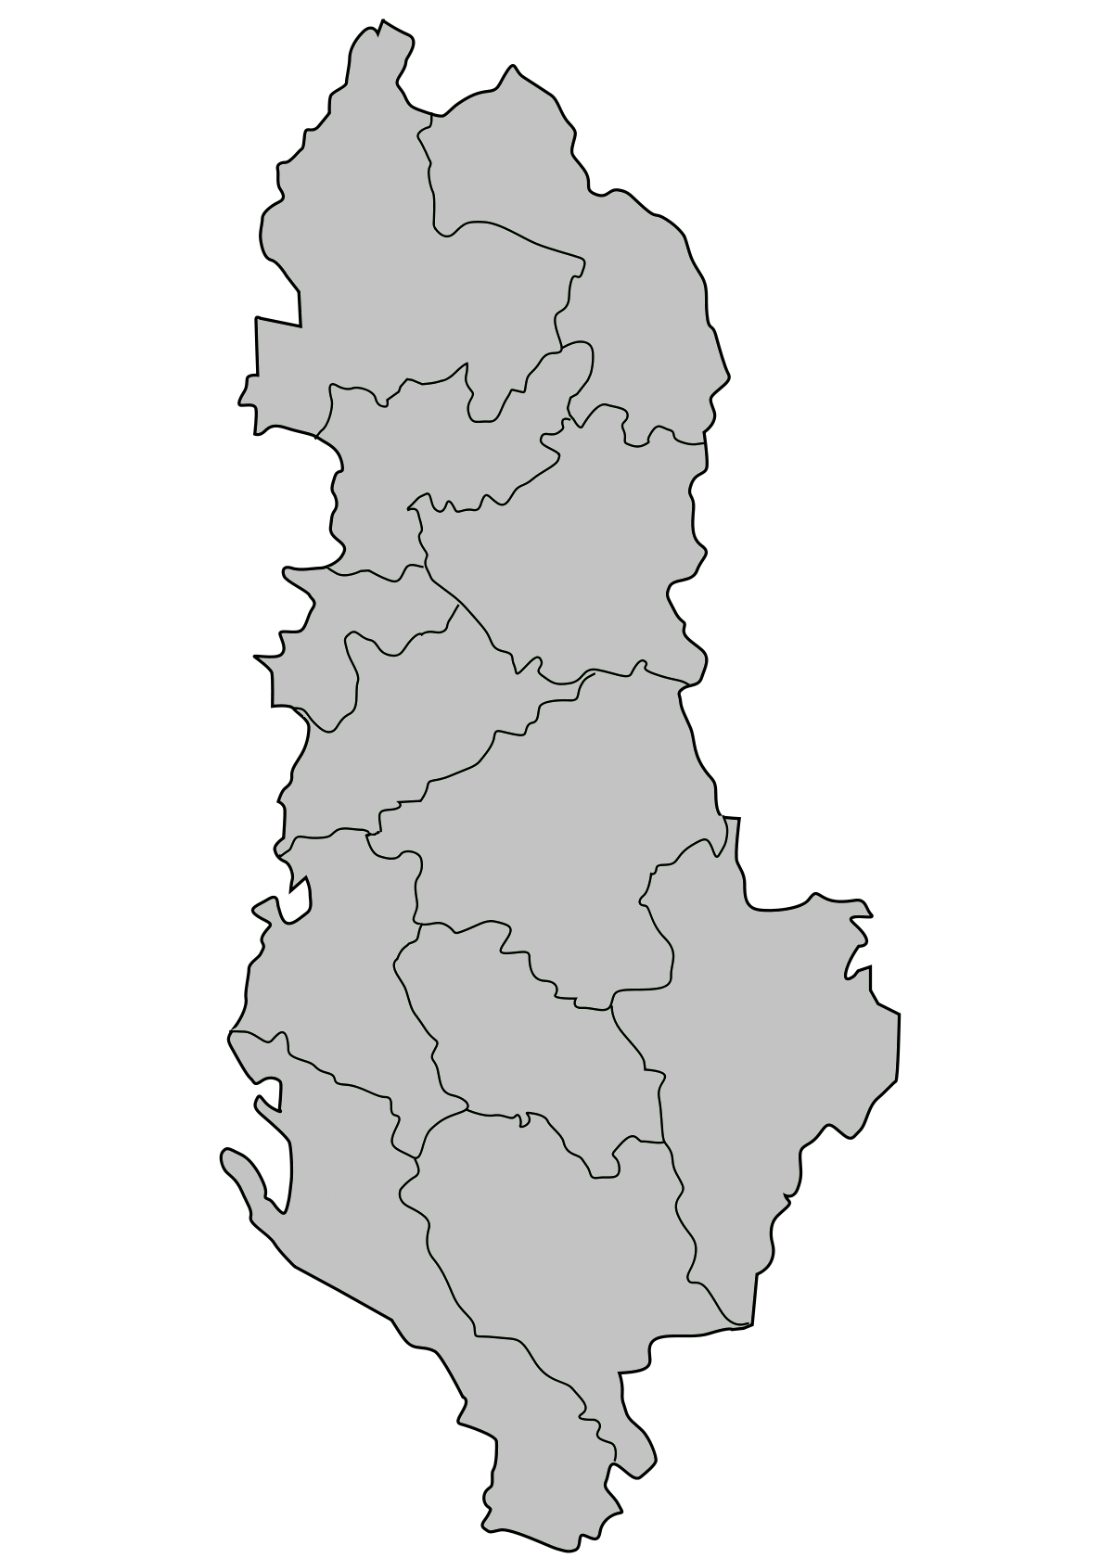
Demographics of Respondents
1. Survey Distribution by Gender
5. Survey Distribution by Region
53%
Shkodër 7%
Kukës 3%
47%
2. Survey Distribution by Age Groups
Lezhë 5%
18-30
33%
Dibër 4%
31-45
Durrës
10%
30%
46-60
25%
Tiranë 31%
61-75
12%
Over 76
1%
Elbasan 10%
3. Survey Distribution by Settlement
Fier 10%
Urban
64%
Berat 4%
Korçë 7%
Rural
36%
4. Survey Distribution by Education
Vlorë 7%
Gjirokastër 2%
Up to Elementary
23%
High School
44%
Higher Education
33%
Notes:
© Copyright Showeet.com

Slide 6
2020 Key Findings
Albanians feel disconnected from government and politics, with two-thirds expressing dissatisfaction with the work of governing institutions and opposition bodies.
More than two-thirds say that access to public information is important to them. Citizens want to know who funds electoral campaigns of political parties and candidates and how such funds are spent. Focus group participants believe that such information is kept away from them.
Compared to 2016, citizens see more opportunities for engagement with civic initiatives than with political parties.
Among undecided voters or those unlikely to vote (comprising 52% of the sample, 44% say that they are not represented by the political parties, followed by 27% who say that parties would not deliver on their campaign promises.

Slide 7
2020 Key Findings
Likelihood of voting declined by 21 percent when compared to the 2016 survey, reflecting disillusionment with governing institutions and opposition bodies. Citizens overwhelmingly feel un-represented by political parties.
While citizen engagement has decreased since 2016, Albanians show more readiness to take action on issues that matter to them.
Albanians are highly critical of parliamentary transparency in general; 3 out of 10 say that parliament has operated transparently during the Covid-19 pandemic.
Respondents overwhelmingly favor voting for individual MP candidates directly, instead of closed party lists, as a mechanism to diminish party leadership influence and improve parliamentary accountability.

Slide 8
Knowledge and Interest
Core indicator

Slide 9
Knowledge and Interest
Albanians’ perceived knowledge and interest in politics dropped by 8% since 2016; however, respondents report increased knowledge of and interest in the role of the presidency.
Youth (18-30 years) report the lowest level of knowledge about politics and, together with female respondents, are least interested in politics.
Two-thirds of citizens say that access to government information is important to them.
Two-thirds say it is important to know where political parties get their money, and how they spend it. Focus group respondents believe that lack of transparency on political finance fuels corruption.

Slide 10
Perceived level of knowledge, 2016 vs. 2020

Slide 11
Interest in politics, governing and opposition bodies
Notes:
Let´s add the title on the graph

Slide 12
Perceived level of knowledge by age group Youth (18-30 years) report lowest levels of knowledge about political party programs, parliament, and MPs.

Slide 13
Interest in politics, governing and opposition bodies by age Youth (18-30 years) report lowest level of interest in political parties and role of MPs “Politics is governed by a small number of people and there is no space for talented individuals with integrity.” Man, 24, Tirana

Slide 14
Interest in politics, government and political bodies by gender Women respondents have lower level of interest across all the issues compared to men

Slide 15
Importance of free access to information in possession of public authorities “There is a lack of information and transparency. If there was more transparency people would be more interested and involved in politics.” Woman, 24, Fier

Slide 16
Interest in where political parties get their funding and how they spend it “The problem is that party funding is huge and hidden. Part of it is done through big public procurement” – Woman, 43 , Korca. “Lack of transparency leaves space for corruption” - Man, 18 Fier.

Slide 17
Political Engagement and Participation
Core indicator

Slide 18
Engagement and Participation
Citizens increasingly look beyond political party avenues to influence government decision-making, such as through CSOs.
There is a consistent decline in party membership since 2016. NGO membership remains low, but stable since 2016.
There is a significant decrease in likelihood to vote since 2016, fueled by distrust in political parties and disconnection from elected representatives.
Citizens employed in the public sector are the only group expressing strong likelihood to vote.
Civic duty comes up as the most common reason for those likely to vote. Lack of representation by the existing parties and distrust in party ability to deliver on promises are main reasons for not voting.
Donating money to a political party is unthinkable for most, driven by a strong belief that parties and the political system are corrupt and unrepresentative.

Slide 19
A 12% drop in political party membership since 2016

Slide 20
Voting likelihood 2020 vs. 2016

Slide 21
Vote likelihood by employment status – 2020 “I will vote because I consider it a moral obligation and a constitutional right. It is a way to ask for accountability from the person you have voted”. Male, 43 years old, Durres

Slide 22
Reasons for voting / not voting “I have voted because I believe that my vote could bring change. I believe that protests cannot bring change if they are not accompanied with voting. I don’t believe that involvement in politics can be done only through political parties. There are other ways to be involved, like voluntary work for example” Woman, 21, Berat

Slide 23
Political/Civic engagement over the past 12 months A significant drop in most forms of engagement since 2016
Have you done any of the following over the last 12 months?
Comparison 2016 vs. 2020

Slide 24
Actual engagement vs. willingness to engage - 2020020)

Slide 25
Reasons for lack of engagement over the past 12 months “What does not motivate me is that the voice of the citizens is not being heard at all. ” Female, 35 years old, Korca

Slide 26
The less personal the cause, the lower the likelihood to engage

Slide 27
Compared to 2016, Albanians are more likely to engage with civil society initiatives through social media and online petitions and less likely to join a party.

Slide 28
Donating money to political parties
“Political parties spend their money in buying votes”
Man, 45, Dibër
“Funding of parties is directly linked to corrupt business practice. Business that donate have links with political parties and do so for benefiting from public contracts” –Man, 25, Tirana

Slide 29
Efficacy and Satisfaction
Core indicator

Slide 30
Efficacy and Satisfaction
Sixty to seventy percent of Albanians are dissatisfied with the performance of state and political bodies.
Citizens feel that they can exert slightly more influence on decision-making at the local rather than at the national level.
The Electoral Reform Agreement of June 2020 is seen more as a party-protection measure than as a reform addressing the public interest.

Slide 31
Satisfaction with governance

Slide 32
Perceived influence on decision making at local and national levels

Slide 33
Assessment of the June 5th electoral reform agreement Younger respondents (18-30) were less likely to agree that ´June 5th Agreement´ represents the interest of citizens and more likely to say that it represents the interest of political parties.
On June 5, 2020 political parties reached an agreement about the electoral reform. To what extent to you agree or disagree with the following statements about the agreement?
Notes:
The women tend to be more undecided.

Slide 34
Parliament and Elected Representatives
Core indicator

Slide 35
Parliament and Elected MPs
Citizens are highly critical of parliament’s work over the past 12 months. Eighteen (18) percent of respondents consider parliament as “essential to our democracy” in 2020--a 35% drop as compared to 2016.
Citizens are, however, more divided on the performance of parliament during the Covid-19 pandemics.
MPs are seen as caring more about the interests of their parties than those of their constituents.
Albanians want their elected representatives to be educated, connected to their constituency, independent, and honest.
The opportunity to vote directly for individual MPs is overwhelmingly seen as the most effective accountability mechanism.

Slide 36
Views about the Albanian Parliament (percentage of “agree”) 2020 vs. 2016

Slide 37
Performance of parliament during Covid-19 Thirty (33) % of citizens believe that parliament was transparent during the pandemic, while only 17% claim so for normal times.

Slide 38
Most desirable qualities of an MP

Slide 39
Mechanisms to increase MPs accountability and quality
Voting for individual MP candidates directly, rather than closed party lists, is overwhelmingly viewed as most likely mechanism to improve both the accountability and the overall quality of elected MPs.
Younger respondents are particularly resistant to party headquarters controlling the selection of candidates for electoral lists and deciding how they are ranked on those lists.
Citizens lack sufficient information on access to parliament and the possibility of participating in committee sessions.
Survey respondents prefer to meet MPs in open public meetings rather than in the their party offices or Parliament.

Slide 40
Improving MP accountability

Slide 41
Improving quality of MPs
“I see open lists as a filter. I consider it a tight process, because both parties will try to “recruit” good candidates. People are tired and it is ever more difficult to approach the grey electorate” Man, 45, Dibra

